Slide 1

SONG RECOMMENDATION SYSTEM
Capstone Project
MIT-IDSS Oct20-B – GROUP 4
Presented by : Angad Bagga
Lakshminaryanan
Sachin Sawant
Sudeep :

Slide 2

Note:
Executive Summary
Key takeaways
Lakshmi
Though the % provided may not be exact, but after having worked on this project we feel the proportions of each item represent our understanding well
Reference:
Forbes Article - Cleaning Big Data: Most Time-Consuming, Least Enjoyable Data Science Task, Survey Says
Dataversity
Popularity
Content
Collaborative filtering
Understanding the problem and business Impact
Model deployment & App building
Data gathering & preparation
Model building
Feature Engineering
Exploratory Data Analysis
Key steps

Slide 3
Problem & Solution Summary
Lakshmi
What problem is being solved?
The Million Song Dataset is a freely-available collection of audio features and metadata for a million contemporary popular music tracks. Our purpose of using this dataset is to provide an interesting mix of song collections, recommendations by bringing in interesting features by augmenting related datasets
What are the key points that describe the final proposed solution design?
The solution proposed is,
Popularity based recommendation on user play count, song average rating (from IMDb) and region based filter (from IMDb)
Display related content based on a new feature (combination of Song title, artist name, release name, song genre) & additionally lyrics based content recommendation
Sentiment based analysis on lyrics to recommend songs to listeners based on their mood
Collaborative Filtering (user-item based) recommendation using Matrix Factorization
Build an App using Streamlit to showcase the solution
Why is this a 'valid' solution that is likely to solve the problem?
The Million Song Dataset by itself does not have all the features to include variety for listeners and hence our approach helps bring in the variety in terms of augmenting interesting features

Slide 4
Recommendations for implementation
Lakshmi
What are the key actionable items?
Prepare a data pipeline to enable the said features for end users
Build models and evaluate them for accuracy of recommendation (based on score)
Build a Streamlit app to show case the capability as a PRODUCT - Dhwani
What is the expected benefit and/or costs? What are the key risks and challenges?
Expected benefit: Variety in collections and newness in recommendations should fetch repeat listeners
Key risks and assumptions: Our recommendations are based on our data analysis and assumption of success based on insights derived from data analysis. Effectiveness has to be measured live on production to provide improvements dynamically
What other problems need to be explored and in what priority order?
Following problem are yet to be explored, we may have to use A/B testing technique:
Effectiveness of the recommendations for the listeners
Popularity of collections amongst listeners
Creating a hybrid recommendation technique
Data pipeline updates and model updates & maintenance

Slide 5
Sachin
DATA PROCESSING PIPELINE
Redefining insights using 5-Steps of Feature Engineering for Music Recommendation Engine
1
2
3
4
5
IMDb rating + Track Data
Process Song DB
Songs Data
Genre Data
Lyrics BoW
Original data set provided by Great Learning Team as input
1 million songs data
2 million play count data
Add IMDb rating data with region split
Add Track ID and Artist data from SQLite track_metadata.db
Add genre data to songs provided by TU Wien Informatics
422K rows of genre data with songs
MusicXMatch dataset containing a list of the 5000 words the most used in the songs in Bag of Word format
50K song lyrics data
Handle missing values
Handle null
Handle duplicates
Drop unimportant features
Pickle data files

Slide 6
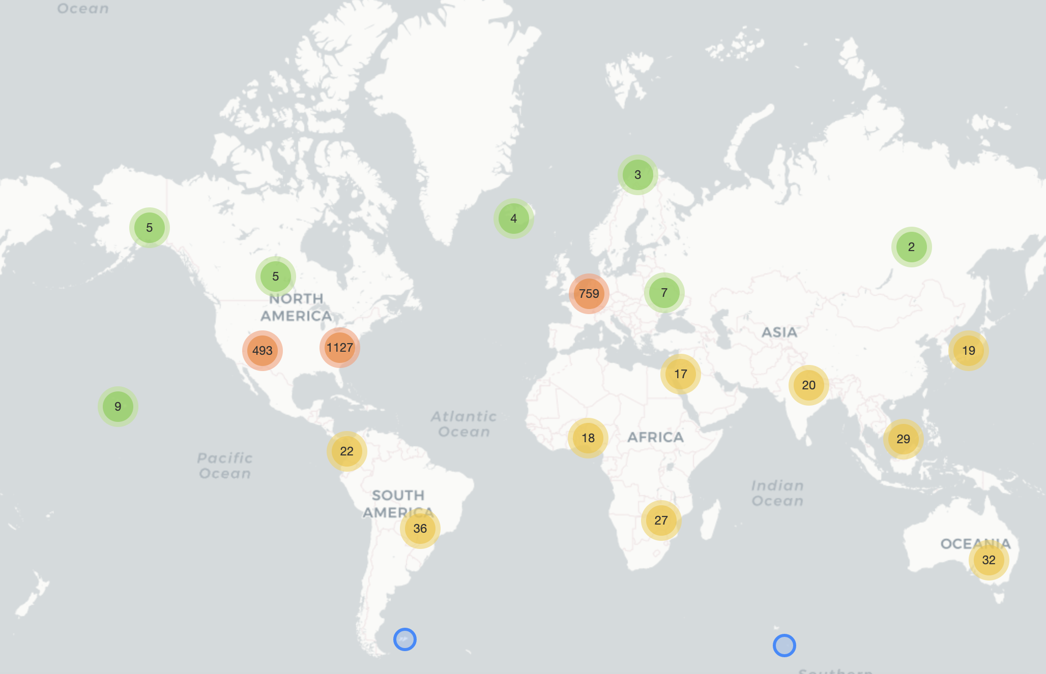
Sachin
How songs are recorded across the world?
The drill-in world map allows us to visualize how songs are recorded across the world.
You can drill in to identify that there are –
82 songs recorded in Mumbai,
36 songs in Pune,
139 songs in Chennai
29 in Karnataka etc.

Slide 7
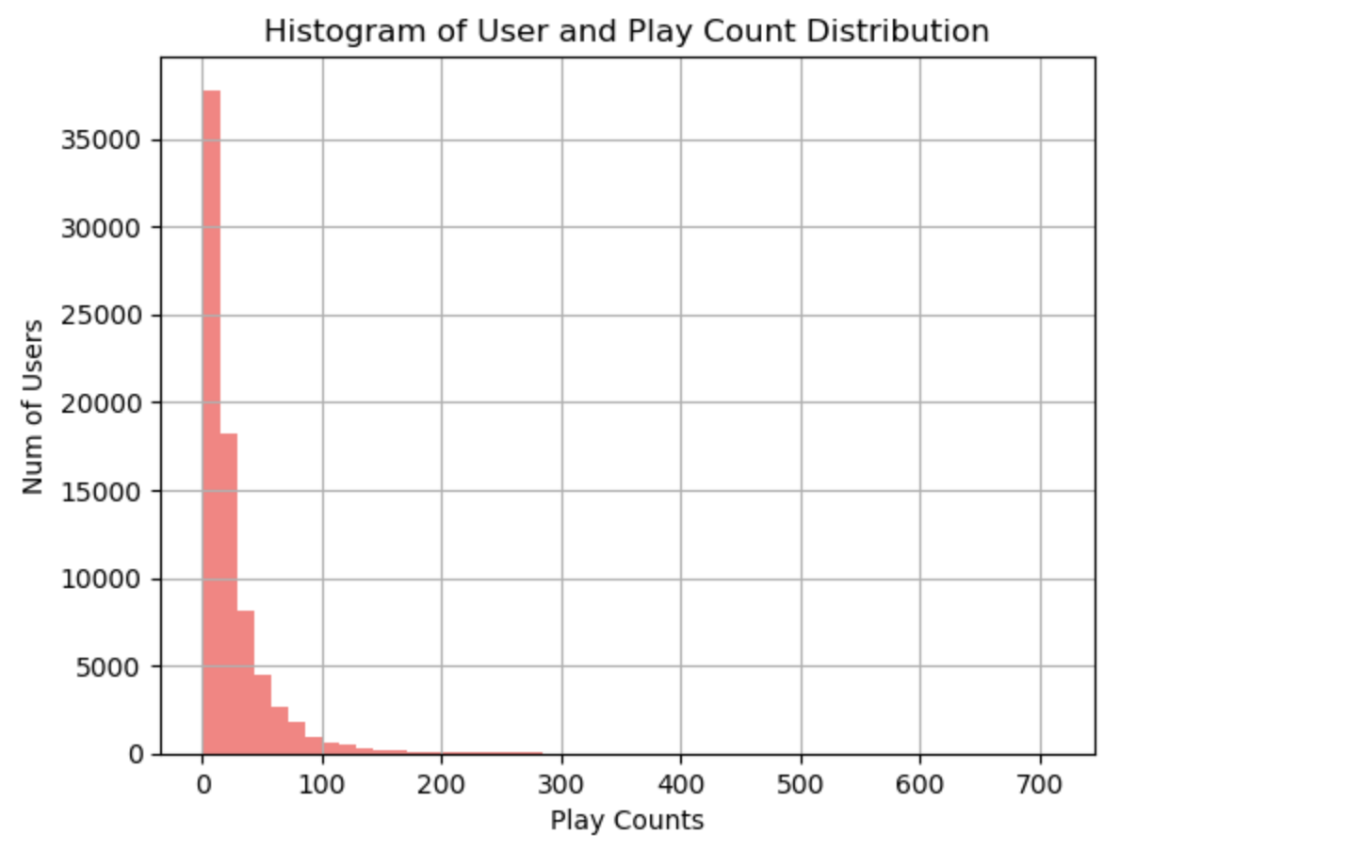
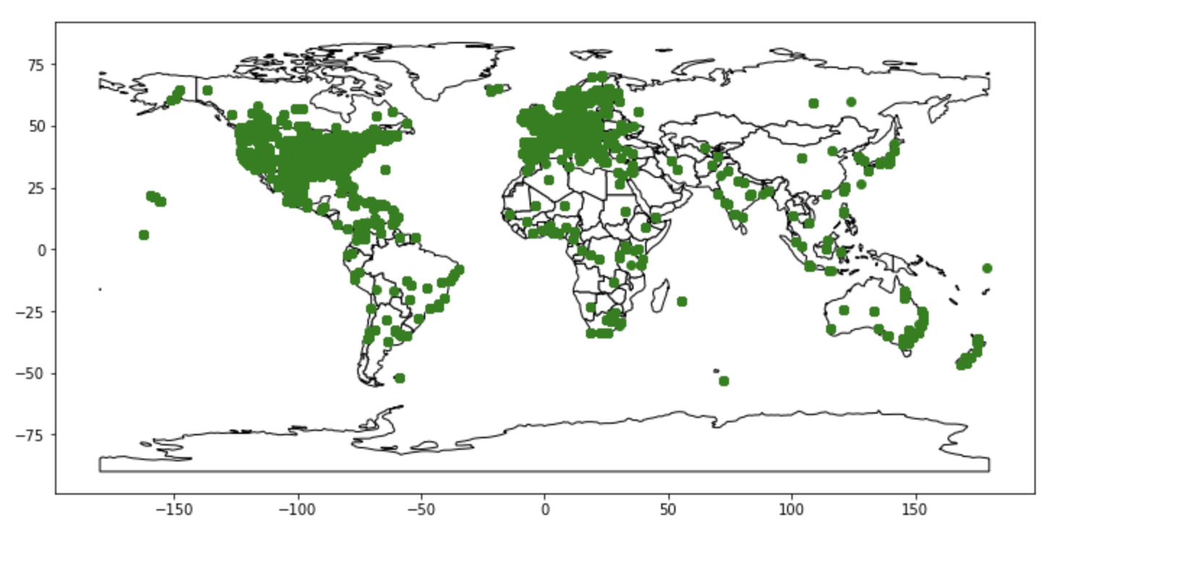
Data Exploration – Distribution by Artists
Sachin
Artist distribution by geography

Slide 8
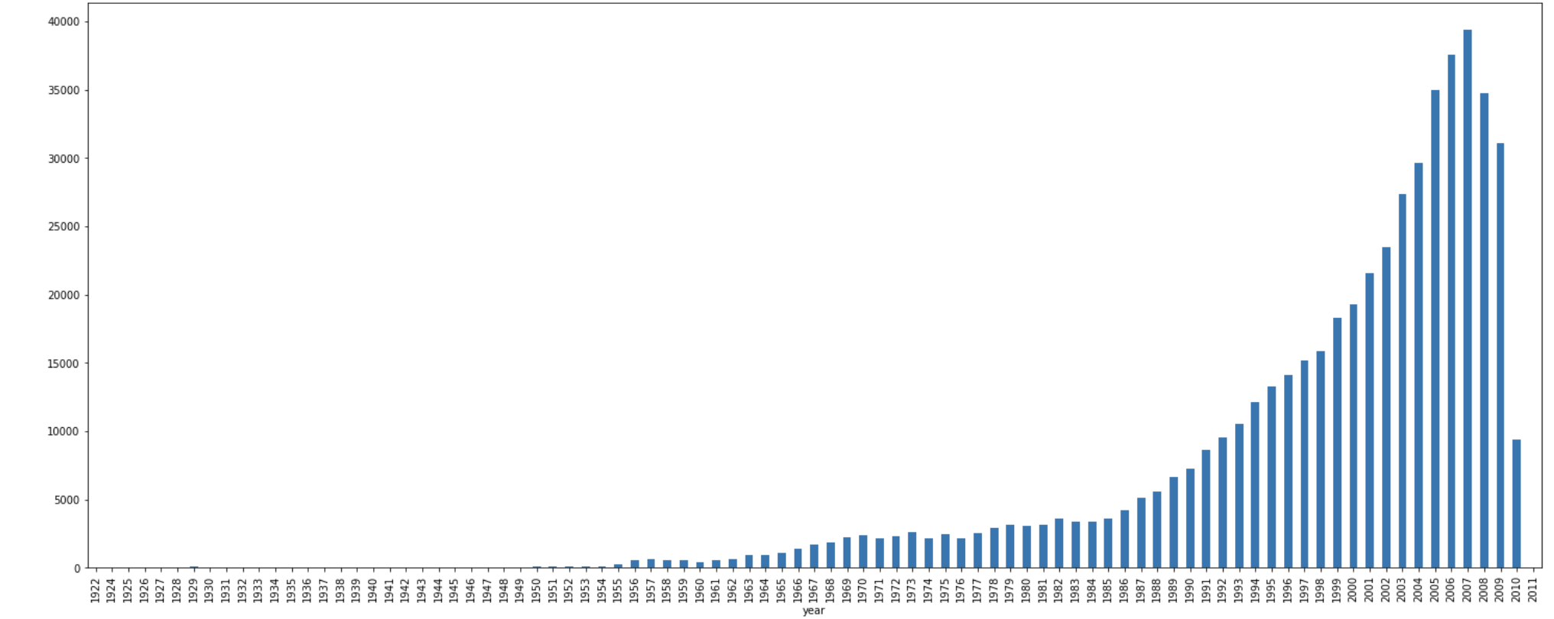
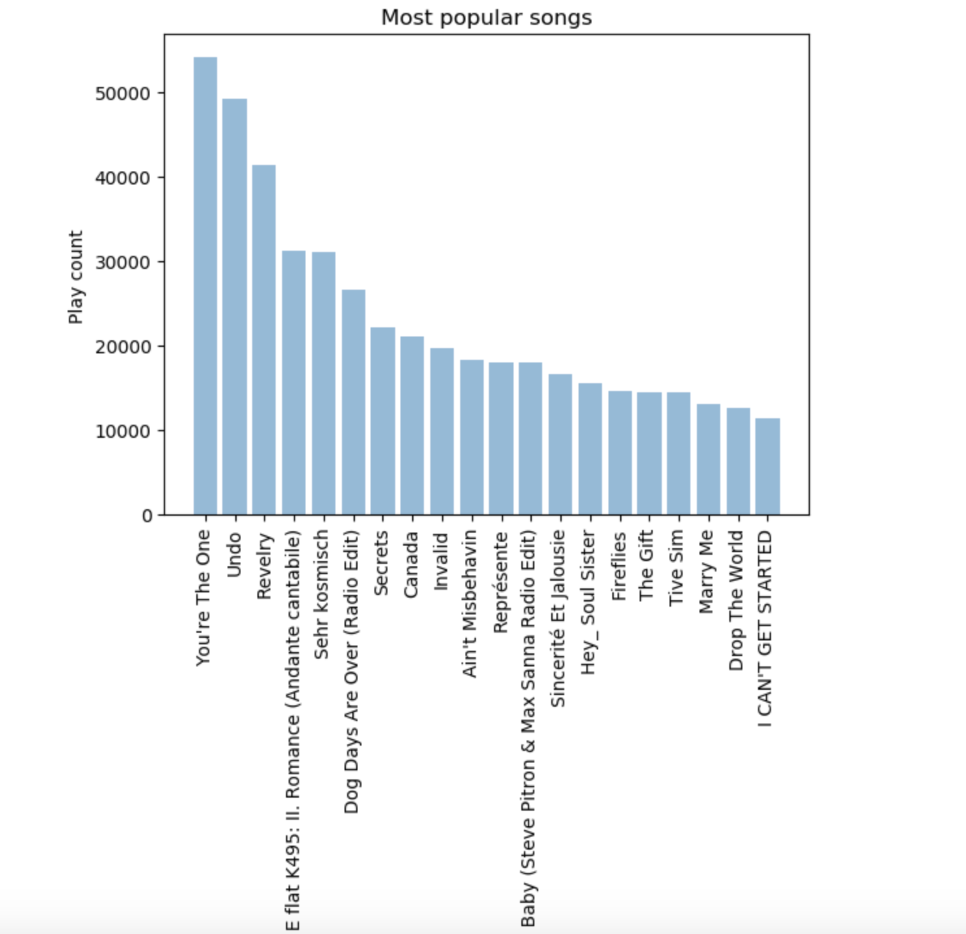
Data Exploration – Number of songs & Popular songs
Number of Songs per year
Sudeep

Slide 9
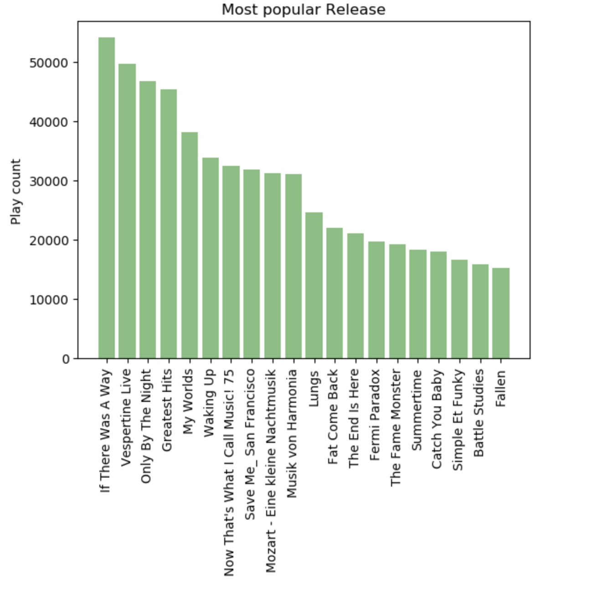
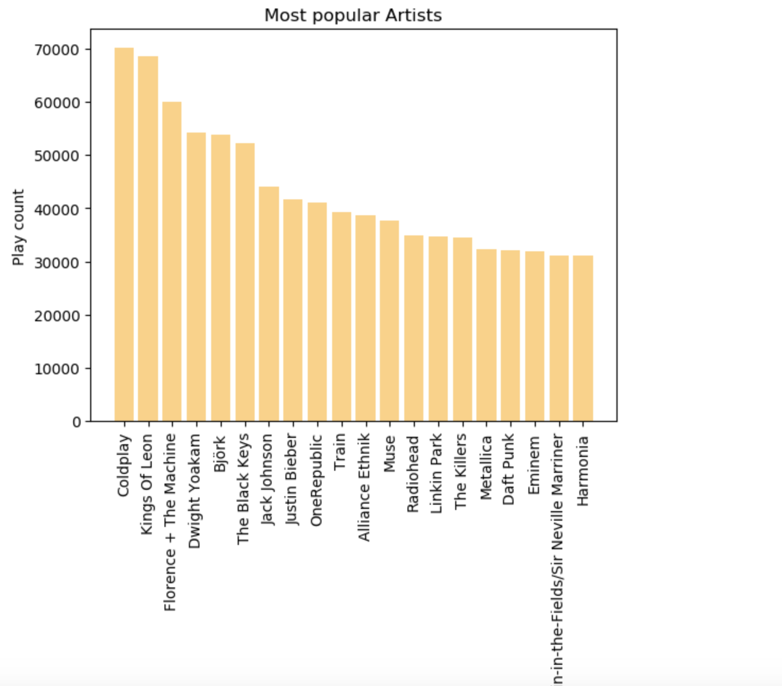
Data Exploration – Popular release & Artists
Sudeep

Slide 10
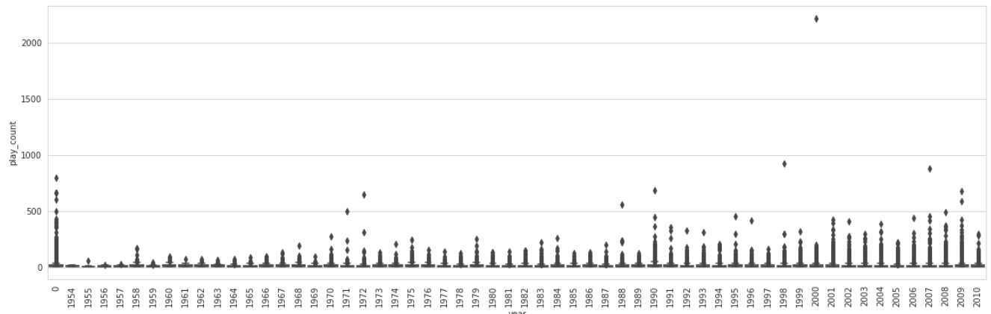
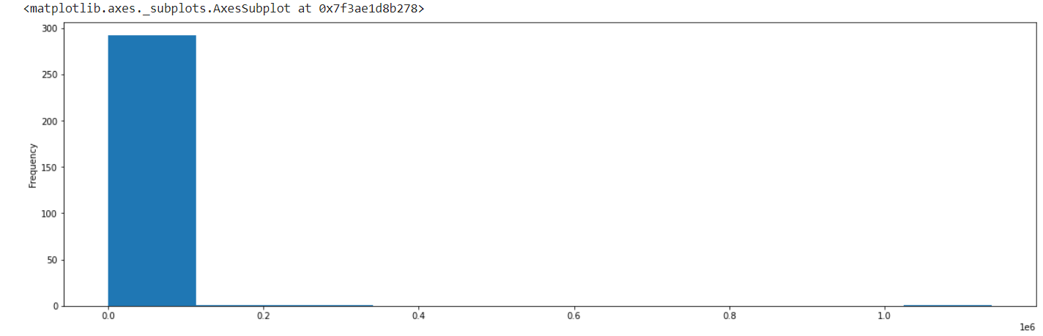
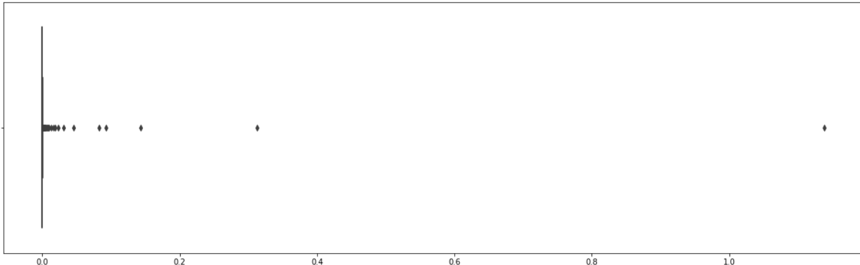
Further Data Cleaning & EDA
We have merged the songs data with the play count data to analyze the evolution of the songs play count over the years & generated a box plot to visualize the data as shown below. It shows that the song play count has increased from the year 1990 onwards. This may be due to more availability of compact discs & improved internet connection over the years.
SUdeep
Concentration of User Play counts
- We can analyze the play counts is mostly in lower rungs

Slide 11

Further Data Cleaning & EDA
Sudeep
Key Steps Taken
Checking Skewness in dataset
Checking NULL values in the dataset
Handling NULL values
Checking Duplicates
Treating duplicates
5 point summary of data sets
Graphical representation of datasets to better understand the data
Merging the dataset for better as applicable for feature engineering

Slide 12

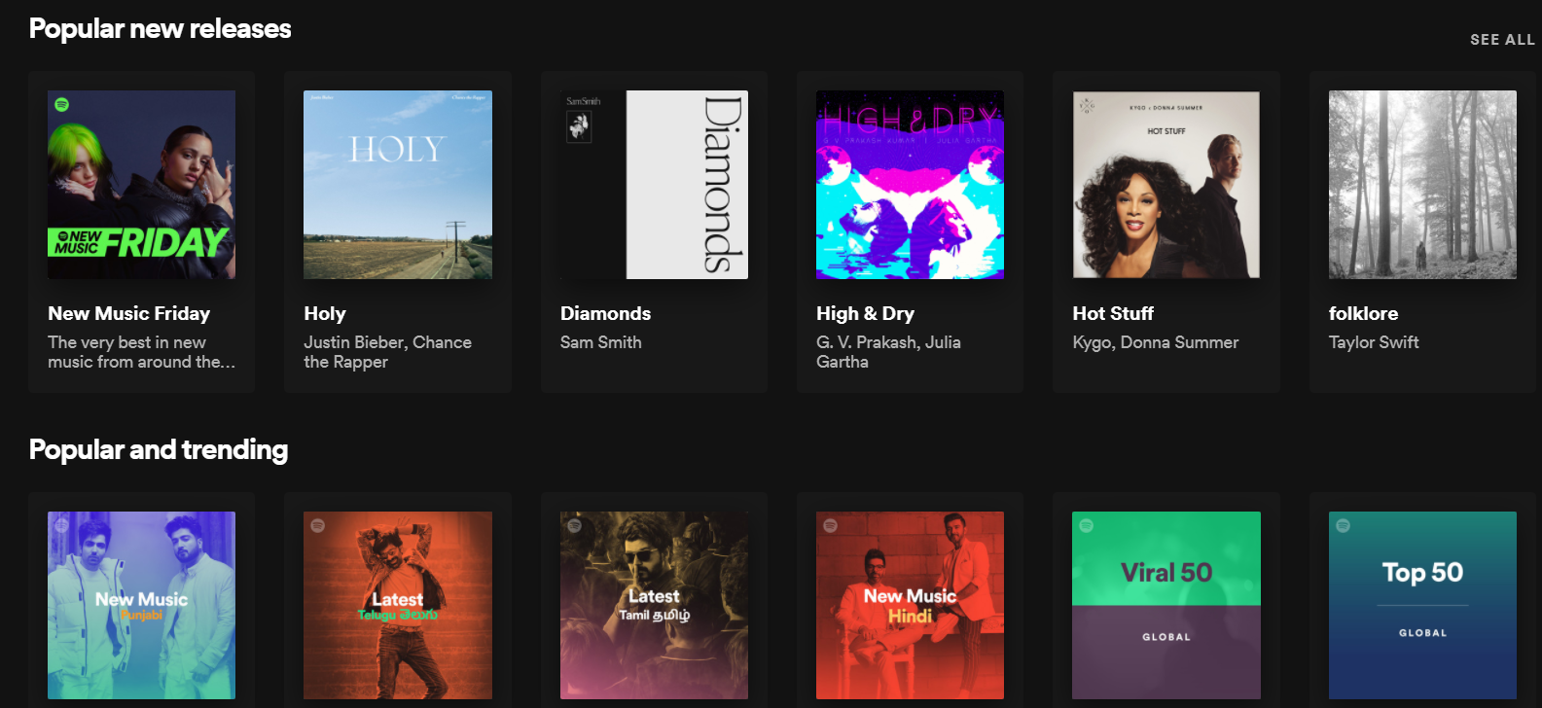
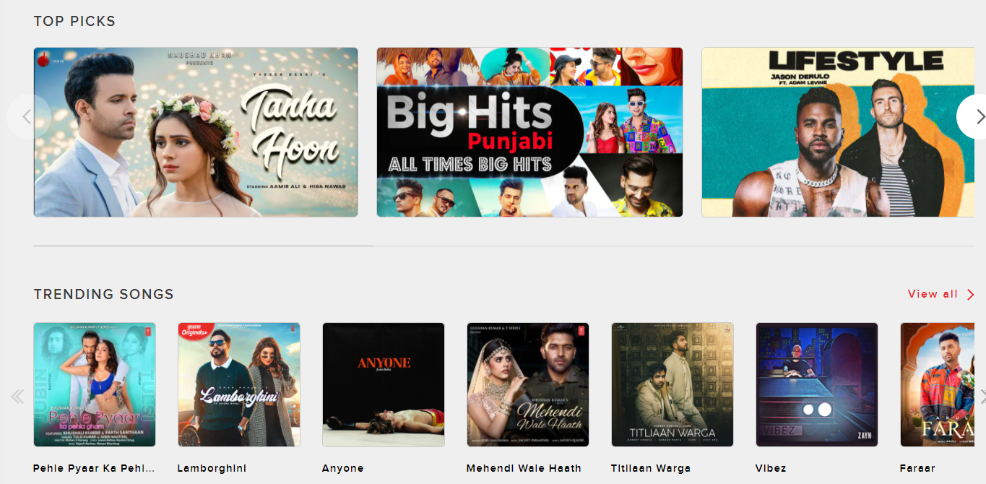

Popularity based Recommendation Approach
How Popularity based Recommendation will help the Customer ?
Angad
It helps with the cold start problem.
No historical data needed for customer.
Customer can upfront visualize the overall popularity and is an exciting feature.
Showing popular new releases can reduce the popularity bias
Snap shot from Spotify.com
Snap shot from Gaana.com
Approach followed in the project to measure Popularity
1. Popularity by number of time song is played by distinct user. While searching we can search top songs with some minimum interaction
Build on top of given dataset
2. Popularity by ratings & number of votes. While searching we can search top songs with some minimum interaction
Introduced a new dataset for ratings and number of votes
1
Created a data frame with count of count of song played by distinct user and sum of songs by Song ID
2
Defined a function that shows top songs based on the
number of interaction

Slide 13
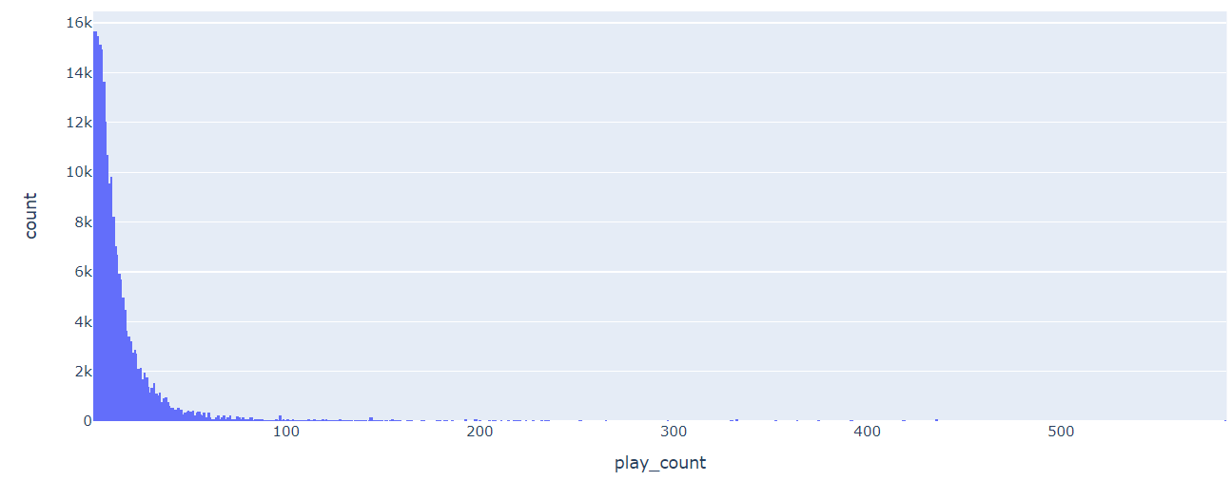
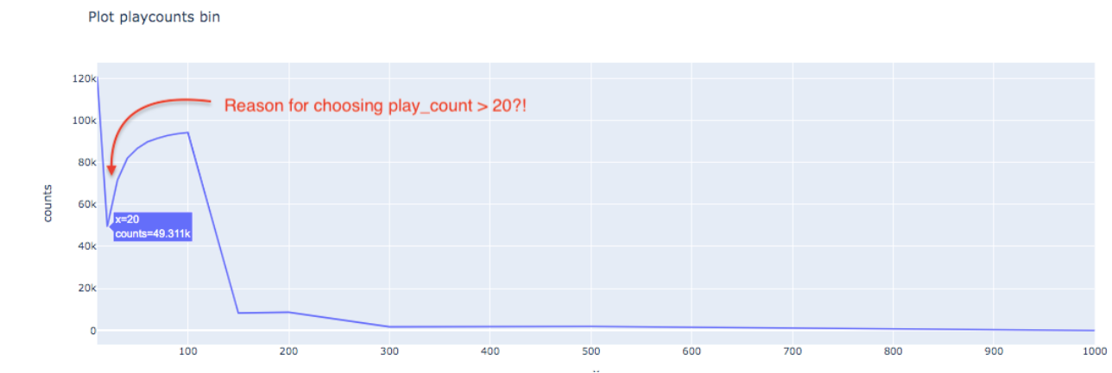
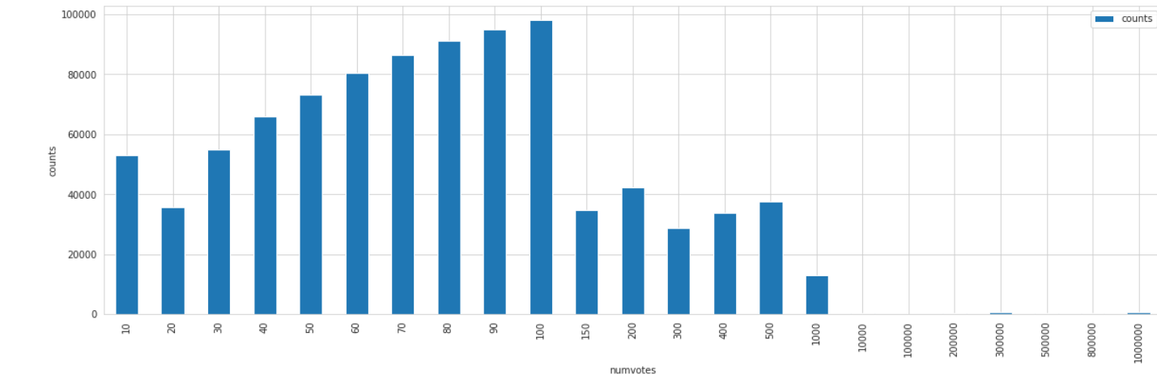
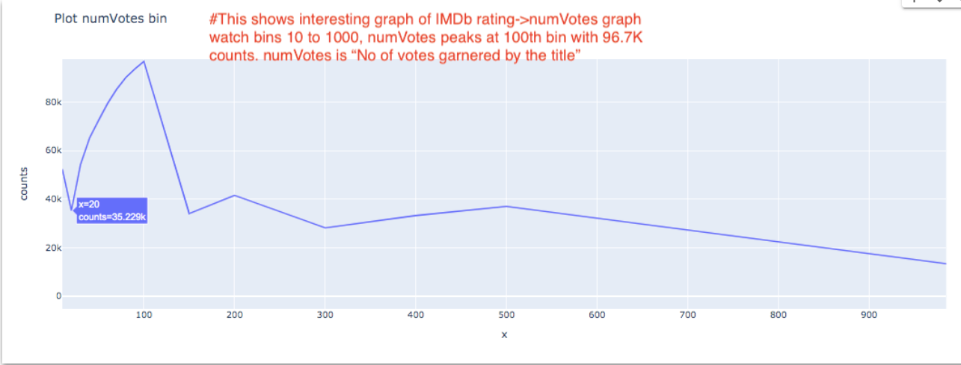
Popularity based Recommendation Graphs
Chosen play count>20 for popularity based recommendation
Angad
Chosen num votes >20 for popularity based recommendation

Slide 14

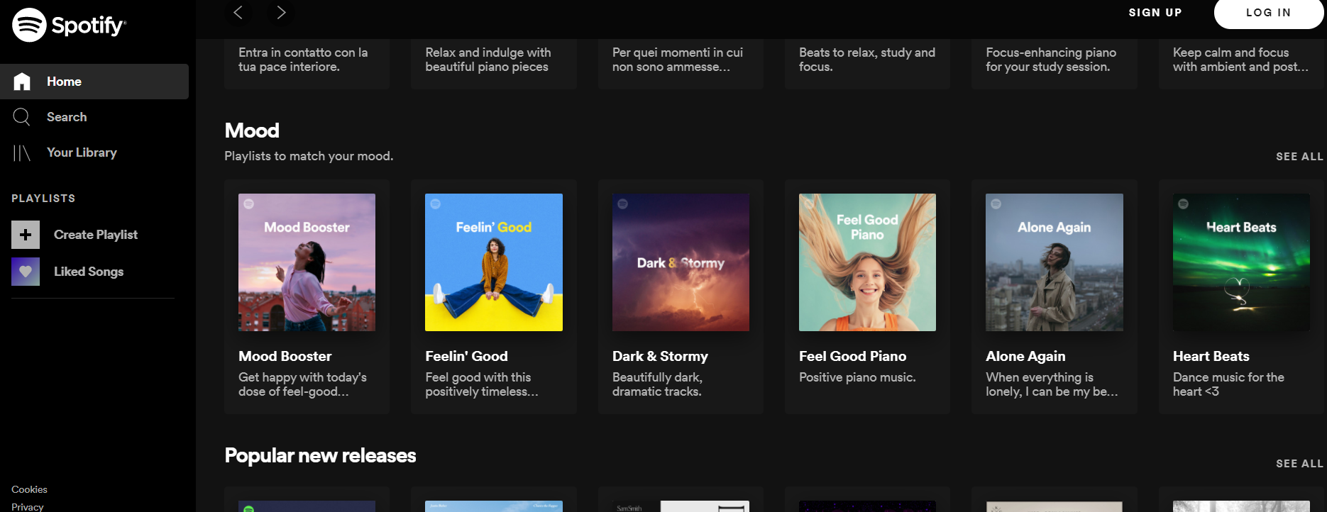
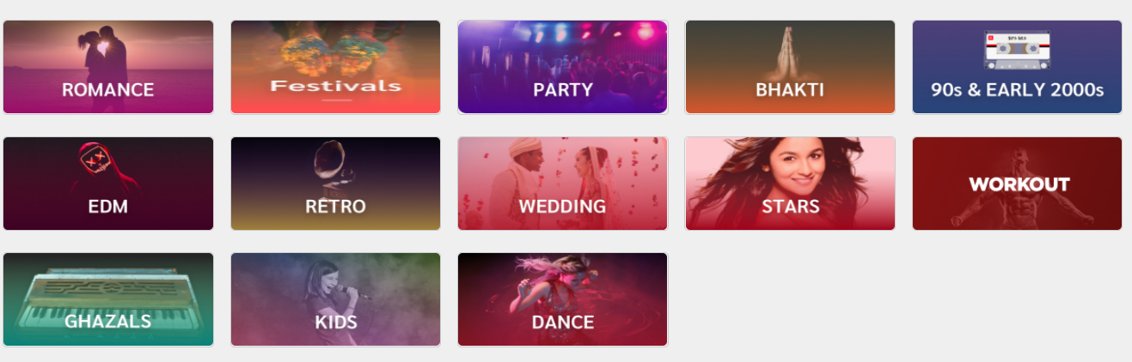

Content based Recommendations Approach
How Content based Recommendation will help the Customer ?
Angad
Recommends similar content to the songs user has liked in the past to give personalized experience.
Doesn’t require a lot of User data
Approach followed in the project for content based recommendations
1. We are using Gensim for content based recommendation as its design to handle large text collections and does not need to have everything in memory at once. Instead of cosine similarity it uses Sparse Matrix
We are using combination of ‘title’, ‘artist’, ‘genre', 'release’
2. We are doing Sentiment Analysis based on the lyrics
Introduced a new dataset for lyrics.

Slide 15
Content based Recommendation - Gensim
Angad
Key Concepts learnt during the journey
Step 1 : Created a data frame song_data_with _Genre & a field named as text which combines ‘title’, ‘artist’, ‘genre', 'release’
Gensim (Generate Similar) library for unsupervised topic modelling
& natural language processing.
All algorithms are memory-independent w.r.t. the corpus size
(can process input larger than RAM, streamed, out-of-core).
For our Project it was suited coz of the data size and processing limits.
TF-IDF - It is the Term Frequency-Inverse Document Frequency model It is different from the regular corpus because it down weights the tokens i.e. words appearing frequently across documents.
For our project it was suited coz we can recommend content
based on Bag of words
Sparse Matrix - Compute similarity against a corpus of documents by
storing the sparse index matrix in memory. The similarity measure used
is cosine between two vectors.
Pickling” is the process whereby a Python object hierarchy is converted into a byte stream, and “unpickling” is the inverse operation, whereby a byte stream (from a binary file or bytes-like object) is converted back into an object hierarchy
Step 2 : Created a list of values in text and after counting the frequencies keeping the words/tokens that occurred more than once.
Step 3 – Pickling Corpus list and creating a dictionary using corpora
Step 4 – Testing with new doc and creating a list bow_corpus
Step 5 : Using tfidf from Gensim & train the model. Also saving gensim_tfidf_model.pkl
Step 6 : Using Sparse Matrix similarity from Gensim
Step 7 – Loading Processed corpus from Pickle and using corpora dictionary
Step 8 – Using Sparsity Matrix Similarity from Gensim & Assigning scores
Step 9 – Created a final data frame with the scores & testing on specific words.

Slide 16
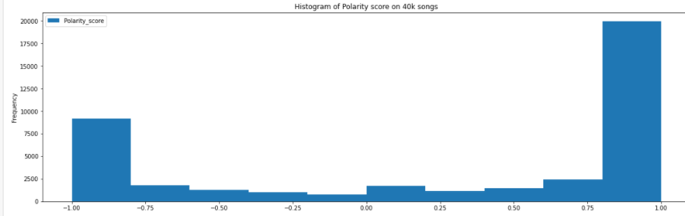
Content based Recommendation - Sentiment Analysis
Sachin
Step 1 : Taking Lyrics Dataset
Step 2: Reading Bags of words and extracting from Dataset
Step 3 : Create set of frequent words
Step 4 : Using TF-IDF and Similarities from Gensim
Step 5 : Using vaderSentiment from NLTK sentiment analyzer.
Step 6 : Applying polarity scores on Bag of Words
Step 7 : Making sentiment category as happy or sad.
Step 8 : Printing the score as per the mood of customer

Slide 17

Collaborative filtering
01
Sachin
User-Song taste - Derive and normalize Implicit Rating
Solution
Leverage the power of matrix factorization to deal with sparsity in user taste profile subset.
02
List 1-3 ways your company proposes to solve them.
Matrix factorization using Singular value decomposition (SVD) to obtain U, S, and V matrices. Reduce S to 50 latent factors.
03
Use truncated resultant matrix U*St and S t*V for prediction or recommendations

Slide 18

Item Based Similarity Model
01
Sachin
Create rating matrix - used implicit user Feedback and mean mean-centering
Calculating similarities between a
user’s items and the other items in our dataset
Solution
02
List 1-3 ways your company proposes to solve them.
Computing the Distance Between songs using cosine similarity
03
Finding Top N Song Recommendations using the nearest N songs for the given Song being listen by the user

Slide 19
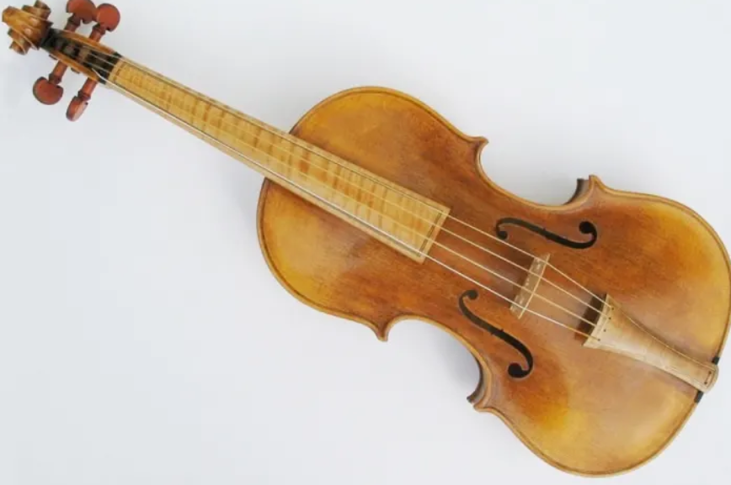
Some Insights - Model evaluation
Angad & Sudeep
Popularity based model is perfect as it shows the top songs when checked through queries.
Searching from title can be different from searching in a combination of “ title, artist name, release, and genre”.
Using str.contains & str.match in text we are able to get the almost same results as content based filtering results for multiple observation.
Finding song recommendation for a set of users gives similar results as in collaborative filtering.

Slide 20
Music heals the soul
Capstone Project
Thanks

